Slide 1

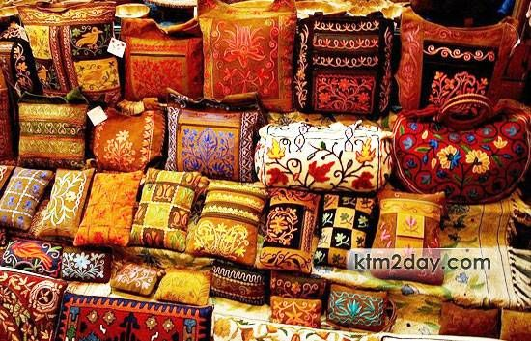
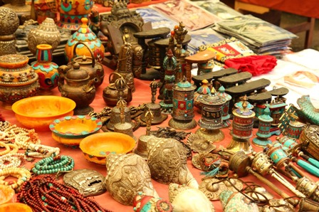
Clothings
Woolen
Felts
Hemps
Singing Bowls
Pashmina
Bags
Papers
Tibetan Gifts
Prayer Wheels
Statue
Silver Jewellery
Metal
Blog
The historical development of Nepalese handicraft industry is very old although has its rise and falls. According to the reference found in Kautilya's Economics about various productions and exports from Nepal, during the time of Chandra Gupta Mouriya, in fourth century, Nepal was known for quality rainproof woollen blankets. The blankets were made of eight pieces joined together of black colour known as "bhiringisi" as well as "apasaraka". Similarly the good quality blankets are mentioned in the epics of Jain religion "Brihatakalpasutra Vhashya". Various famous Chinese travellers like Wanghunshe and Huansang in 648 AD have appreciated Nepalese arts and crafts and the skills of Nepalese craftsmen and artisans in their travelogues.

Slide 2
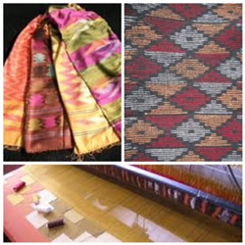
Dhaka
Dhaka is one of the handloom fabrics that is gaining more and more popularity amongst buyers. It is a traditional and intricate handwoven material that is valued for its artful handwork and natural fibers. Beautiful shawls and cloths are commonly made from Dhaka. This traditional pattern weaving is done on wood and bamboo treadle looms by Limbu and Rai women of the eastern hill area (Tehrathum) of Nepal. Each woven item is unique because of the changing of shed. The weaver decides, without chart or counting threads, which section of the warp she is going to lay the colors which form the pattern.

Slide 3
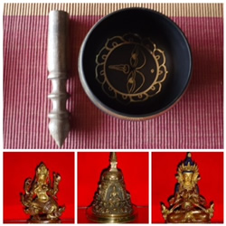
Metal
In Nepal, forging metal images is a very old art. Metal craft products include images of popular motifs of Hinduism and Buddhism, but also utilitarian utensils. These products are mostly produced by household units clustered around the city of Lalitpur (Patan). Metal images are produced with the lost-wax casting. This method of casting is done by preparing a wax model, covering it with varieties of clay, heating the piece so that the wax is melted, extracting the liquid wax so that cavity is created, pouring metal into the cavity, cooling it and transferring the original model into the metal image. The metal image from the casting is very rough. This rough image is then made smooth and made precise by chiseling. This complicated process requires an artist’s conception, an engineer’s perfection and the skillful hands of a craftsperson.

Slide 4
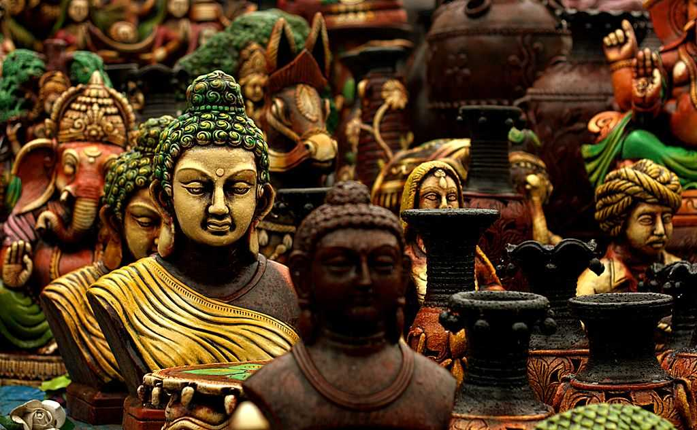
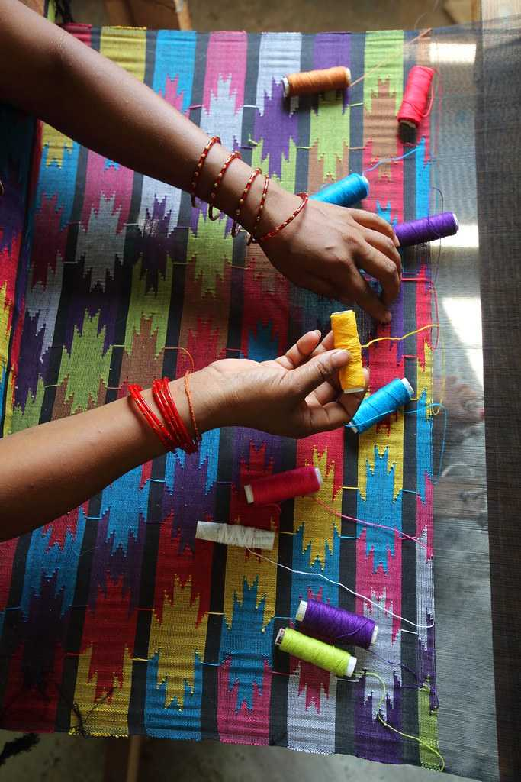
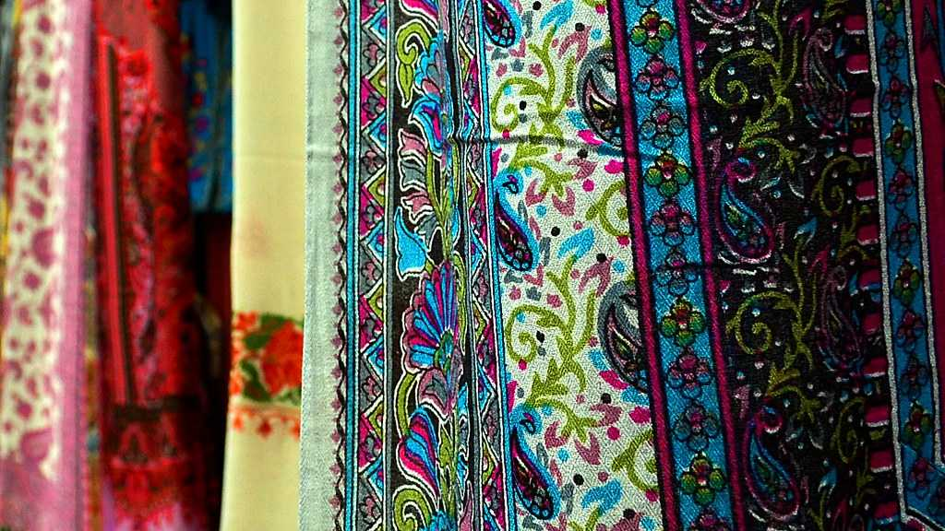
Every time we are on a vacation, we face a tough time selecting budget-friendly souvenirs for our relatives. The handicrafts in Nepal are the perfect answer to your souvenir needs. When discussing the variety of handicrafts of Nepal, this serene place on the laps of Himalayas puts forward a lot of options. It is therefore highly recommended to purchase these fine handicrafts and let their economy grow.

